Slide 1
Day 2: Understanding challenges to reproducibility
David Souto
School of Psychology and Vision Sciences

Slide 2
What are challenges to reproducibility?
QRPs
P-values misconceptions
Power

Slide 3
Session 1: P-values and forking paths

Slide 4
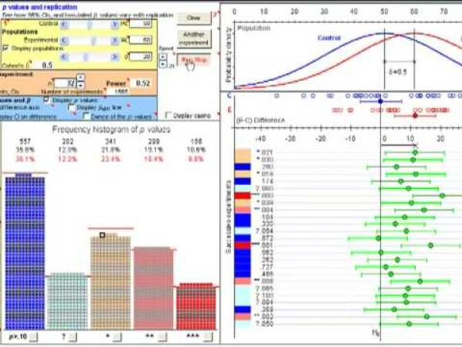
Dance of the p-values (10’)
Notes:
Geoff Cumming made his argument very eloquently in this video, why not watch it

Slide 5
Session 1 Worksheets

Slide 6
Session 2: Power and sample selection

Slide 7
Session 2 worksheets

Slide 8
Session 3: Strength of evidence and sample selection

Slide 9
Session 3 worksheets

Slide 10
Sequential testing with Bayes Factors

Slide 11
Sequential testing with NHST

Slide 12
Alpha spending functions
O'Brien-Fleming when early stopping is less critical
Pocock when all interim analyses are equally important
Haybittle-Peto for very conservative interim analyses

Slide 13
Plan interim analysis
Efficacy boundary
Futility boundary

Slide 14
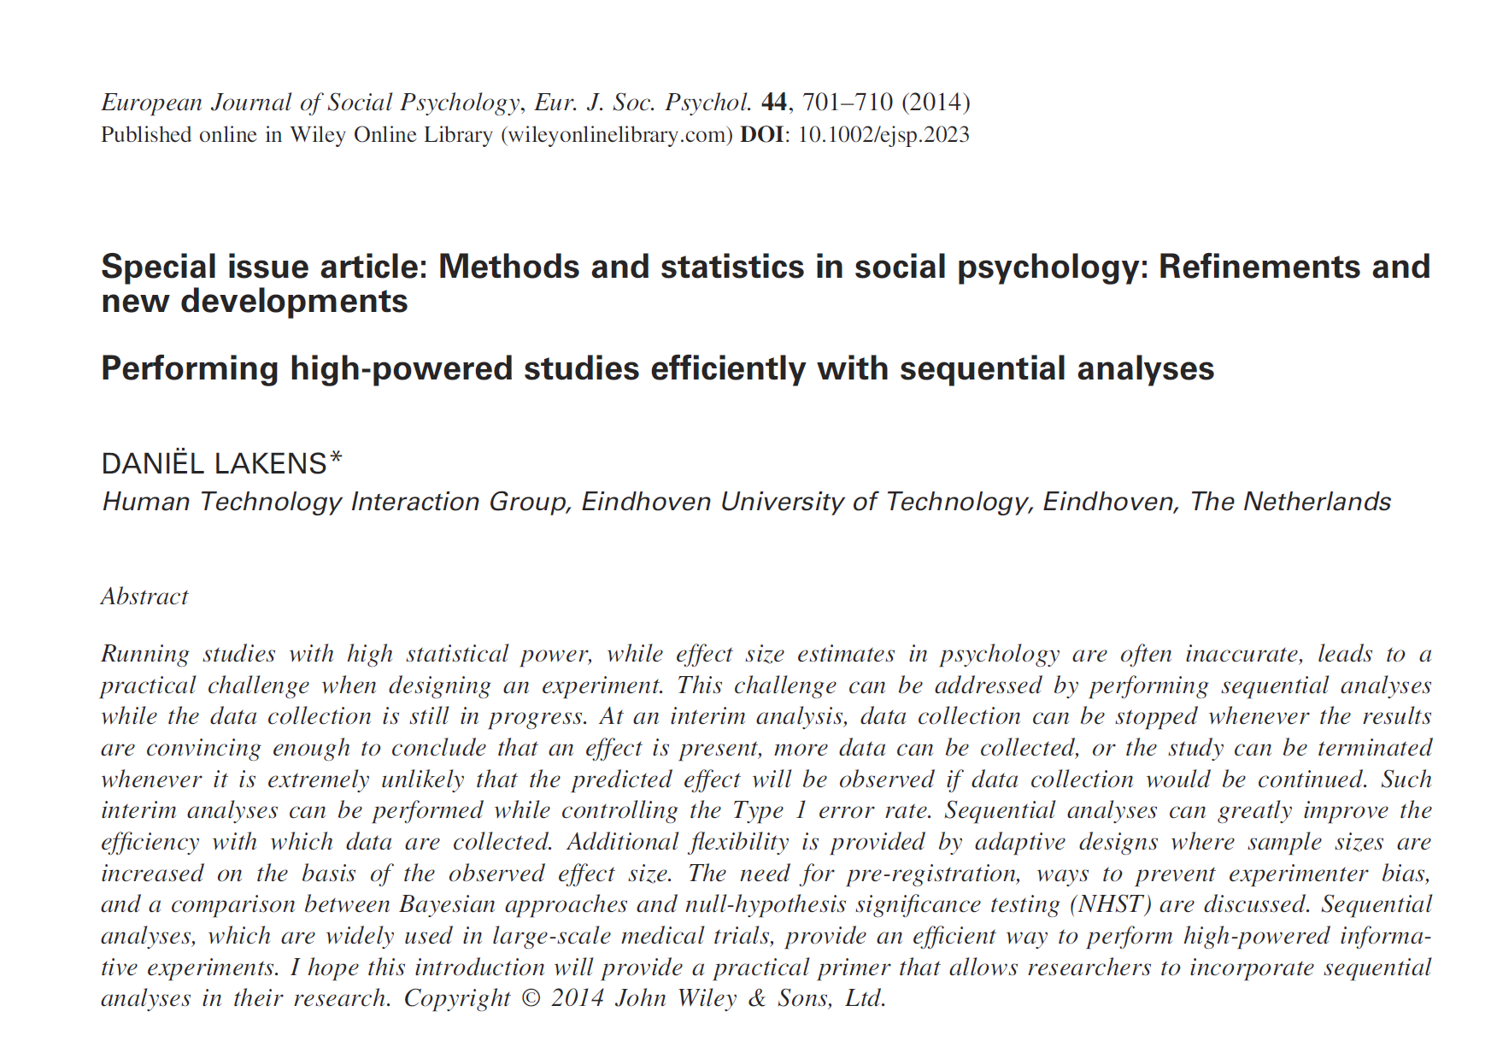
Accessible reference

Slide 15
Report Transparently
Example from Paper

